Slide 1
Dihedrals of different models

Slide 2
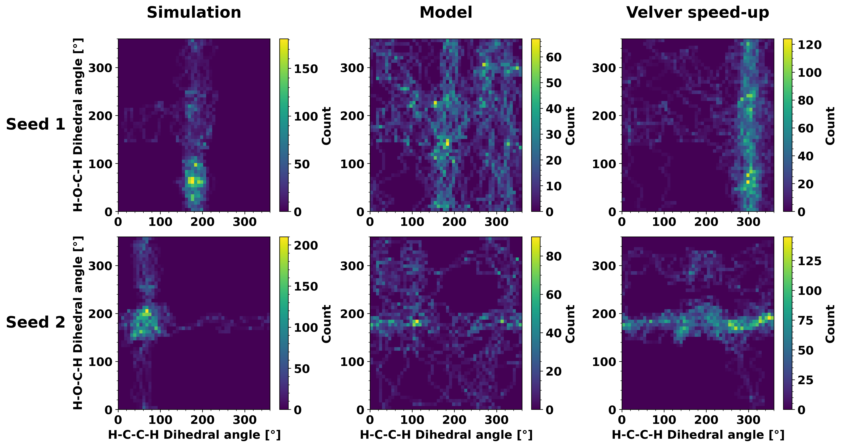
12_2

Slide 3
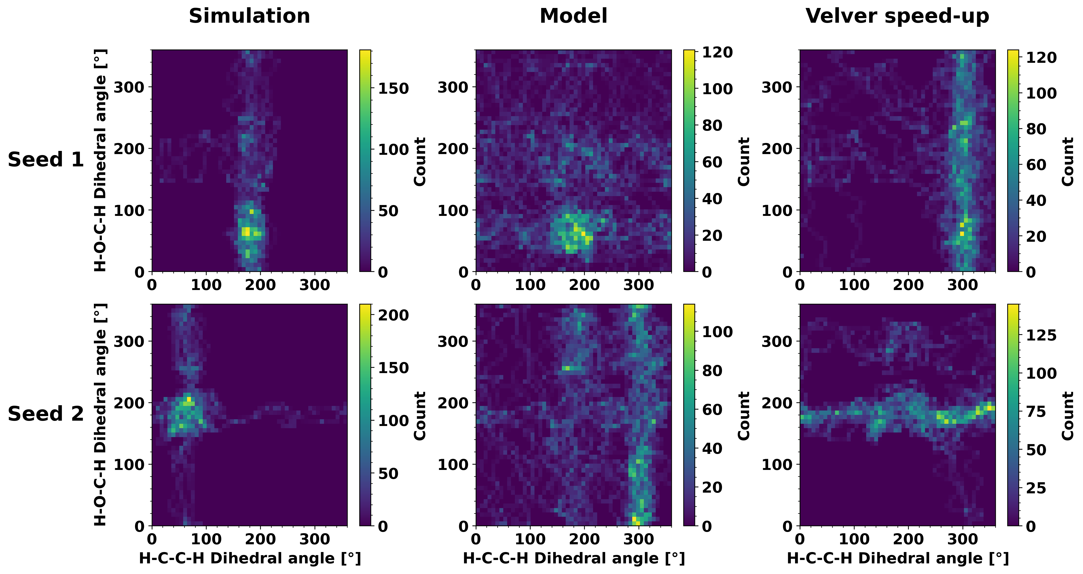
12_2 regularized

Slide 4
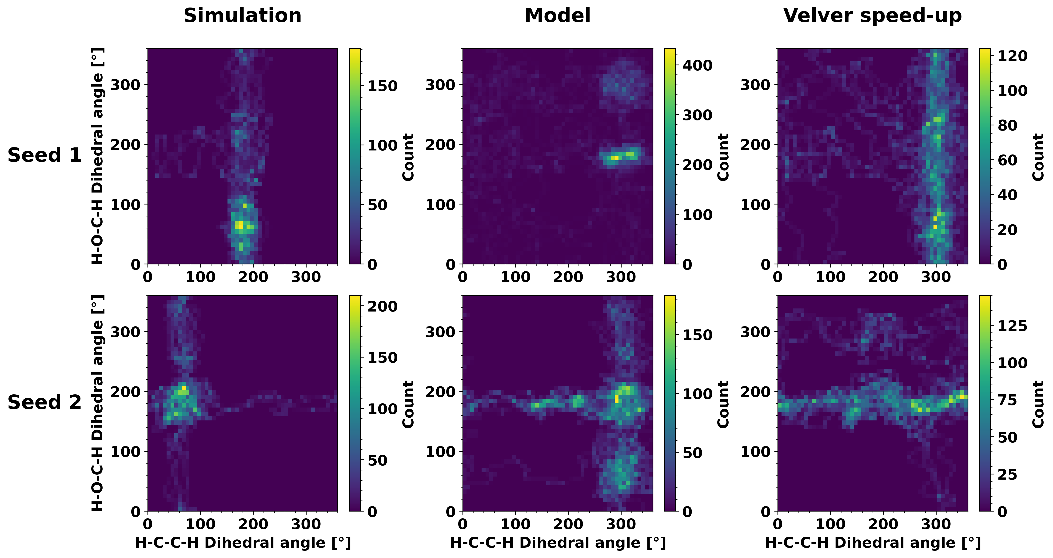
15_4

Slide 5
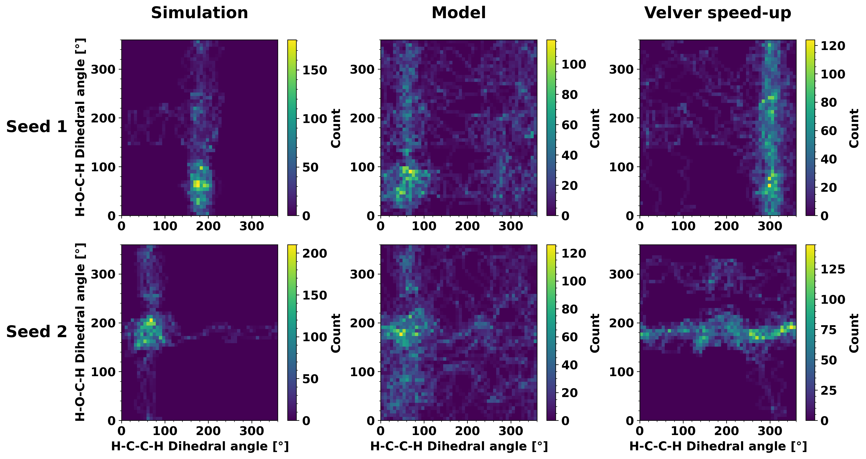
15_4 regularized

